Slide 1
Introduction to Automation Testing using Selenium

Slide 2
What is Software Testing?
It is a method to check whether the actual software product matches expected requirements and to ensure that software product is Defect free. It involves execution of software/system components using manual or automated tools to evaluate one or more properties of interest. The purpose of software testing is to identify errors, gaps or missing requirements in contrast to actual requirements.

Slide 3
Benefits of Software Testing
Cost-Effective
Security
Product quality
Customer Satisfaction

Slide 4
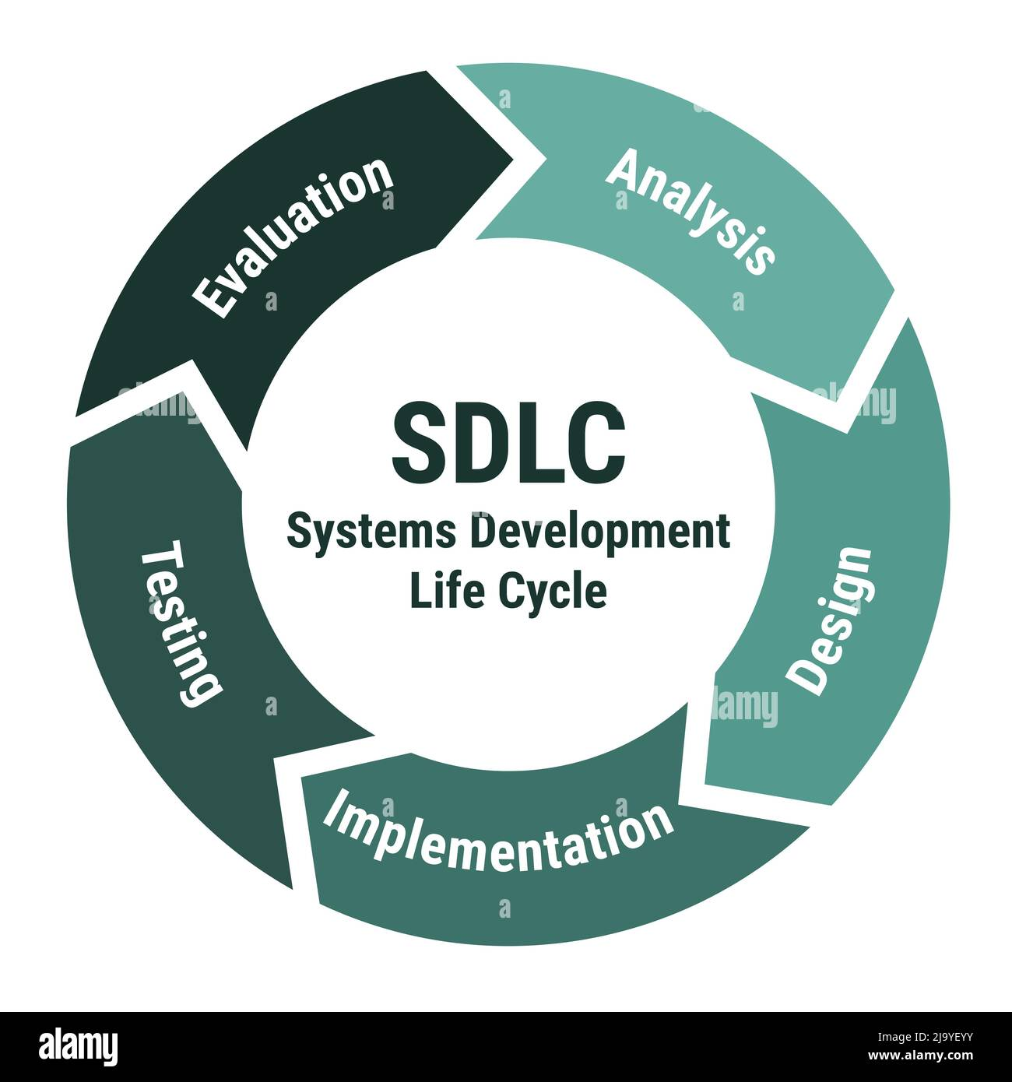

Slide 5
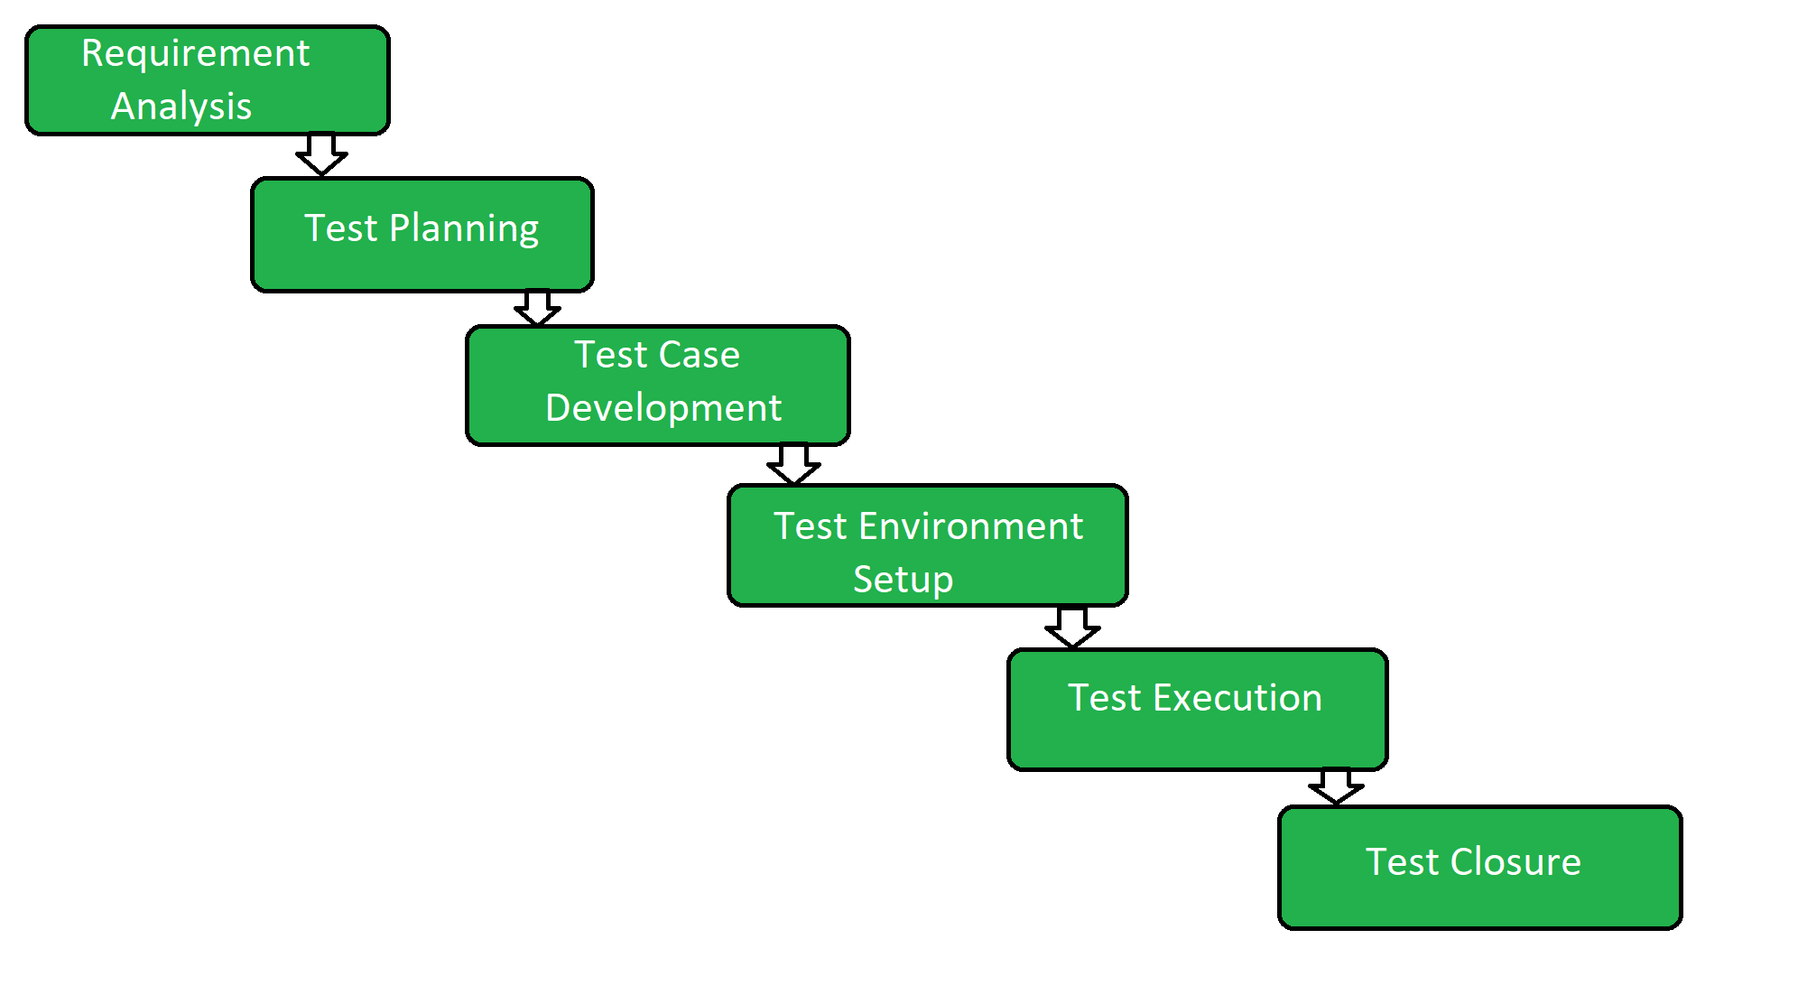
STLC (Software Testing Life Cycle)

Slide 6
Methodologies in Software Testing
Functional - Smoke Testing, Sanity Testing, Regression, Unit Testing, Integration Testing, Feature Testing etc
Non- Functional Testing - Performance Testing, Load Testing, Stress Testing etc

Slide 7
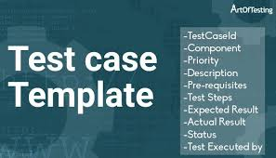

Slide 8
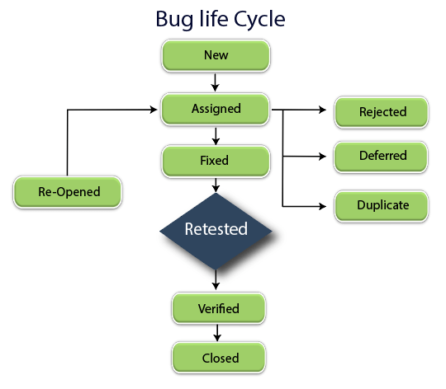

Slide 9
Why should we move from Manual to Automation Testing?
It requires more time than automated testing
It is susceptible to human errors
It is time-consuming to maintain test cases
It is costly to maintain manual testers
Earlier Feedback and Bug detection
Test Reusability

Slide 10
Criteria for Automation Test cases
Which Test Cases to Automate?
Test cases to be automated can be selected using the following criterion to increase the automation ROI
High Risk – Business Critical test cases
Test cases that are repeatedly executed
Test Cases that are very tedious or difficult to perform manually
Test Cases which are time-consuming
The following category of test cases are not suitable for automation:
Test Cases that are newly designed and not executed manually at least once
Test Cases for which the requirements are frequently changing

Slide 11
Automation Testing Scope
Web Automation- Selenium, CyPress, PlayWright, Karate etc
Mobile Automation- Appium, Robotium, Expresso, XCUITests etc
API Automation - Rest Assured, Karate etc
Performance Testing - Jmeter, gatling etc

Slide 12
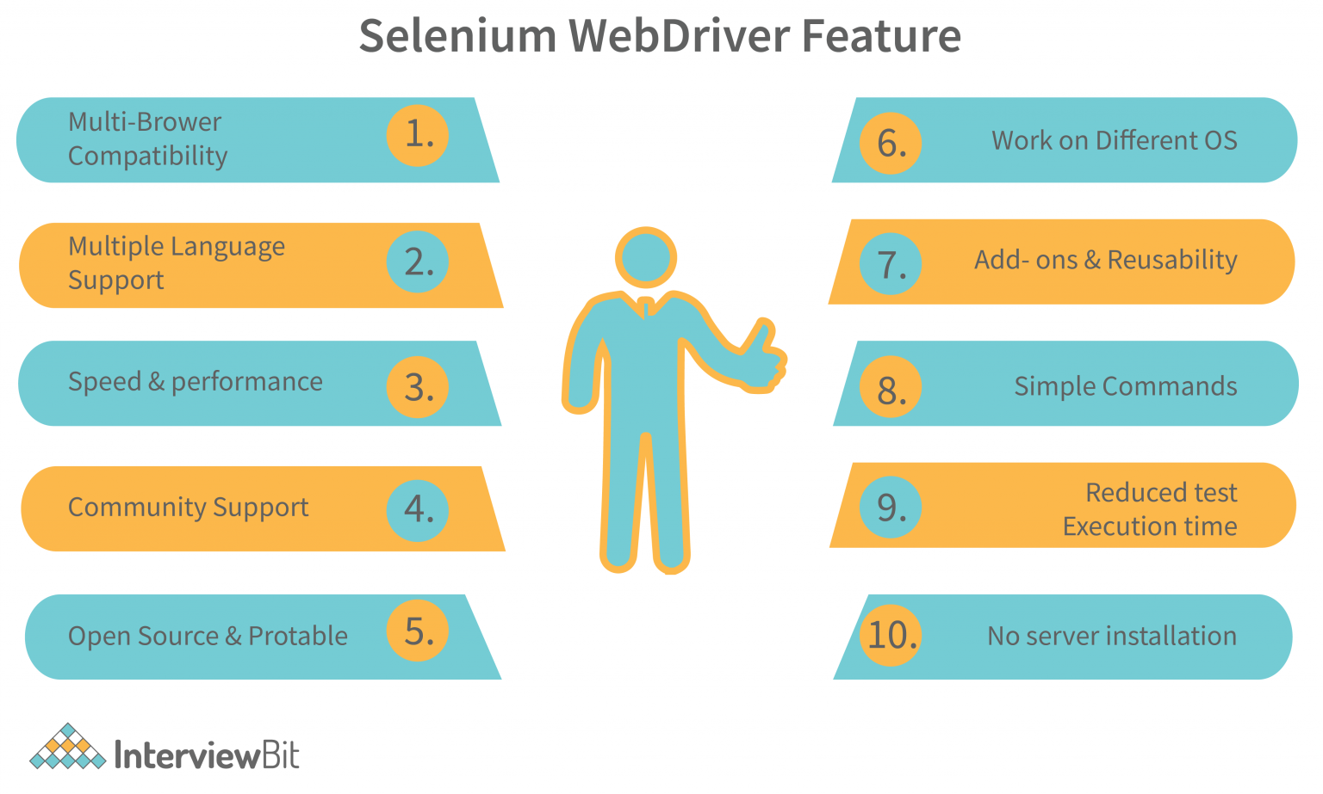
Why Selenium is Preferred for Web Automation over tools in the market?

Slide 13
Selenium Components
Selenium IDE
Selenium Webdriver
Selenium Grid

Slide 14
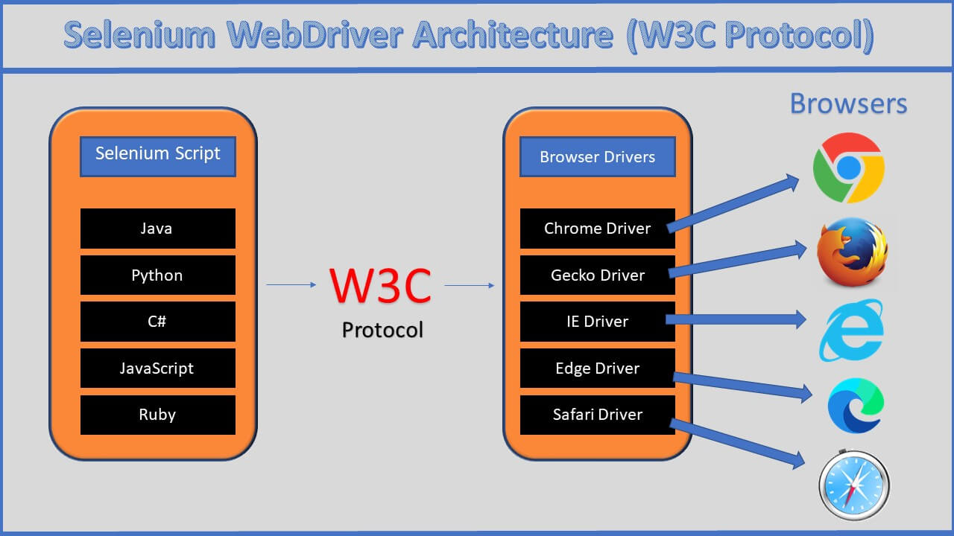
Selenium Architecture

Slide 15
Selenium Locators
Method | Syntax | Description
By ID | driver.findElement(By.id (<element ID>)) | Locates an element using the ID attribute
By name | driver.findElement(By.name (<element name>)) | Locates an element using the Name attribute
By class name | driver.findElement(By.className (<element class>)) | Locates an element using the Class attribute
By tag name | driver.findElement(By.tagName (<htmltagname>)) | Locates an element using the HTML tag

Slide 16
Selenium Locators
Method | Syntax | Description
By link text | driver.findElement(By.linkText (<linktext>)) | Locates a link using link text
By partial link text | driver.findElement(By.partialLinkText (<linktext>)) | Locates a link using the link's partial text
By CSS | driver.findElement(By.cssSelector (<css selector>)) | Locates an element using the CSS selector
By XPath | driver.findElement(By.xpath (<xpath>)) | Locates an element using XPath query

